Slide 1
Restfull Api + AngularJs JAVA
Hylston Barbosa(C0740825)
Keyur Vaidya(C0737700)
Wenji Chen(C0739290)
Group Name- I.B.C.

Slide 2
Introduction
We developed 2 different projects, being the first one a java Restful API and the second an angular project to consume the service;
Our application is based on the Express Entry Rating System. The API is responsible to return scores based on candidate profiles.
We developed the system using the hottest Java technologies and frameworks.

Slide 3

Back-End

Slide 4
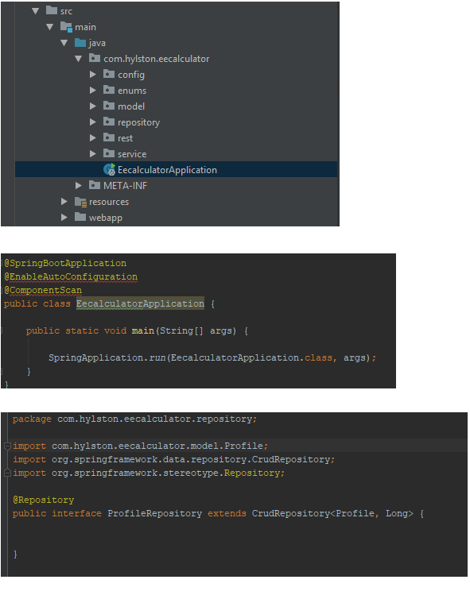

Slide 5
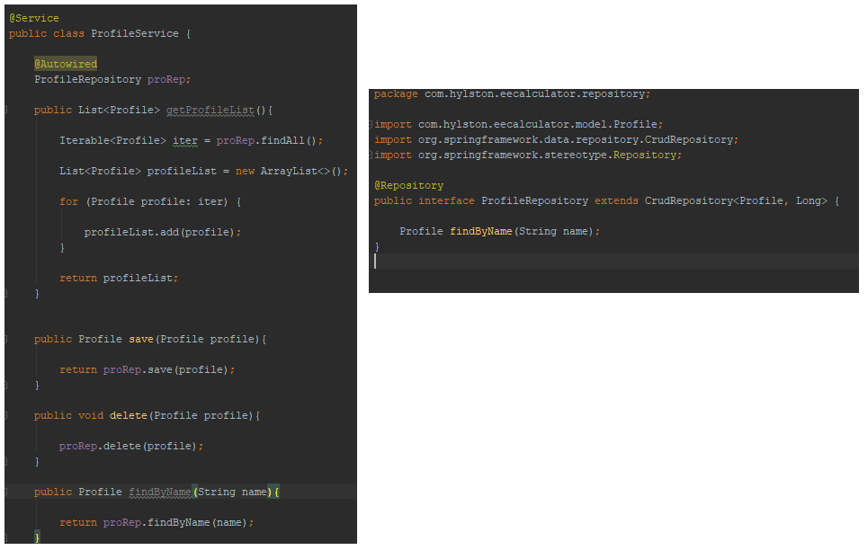

Slide 6
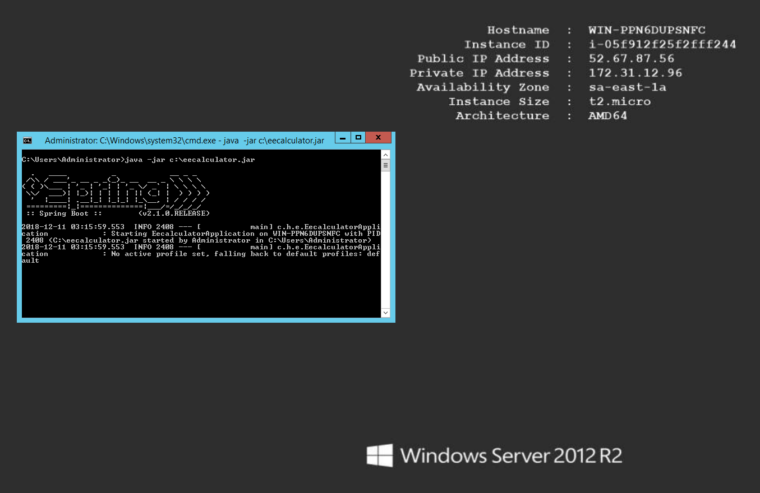
Deploy a Spring Application

Slide 7


Slide 8
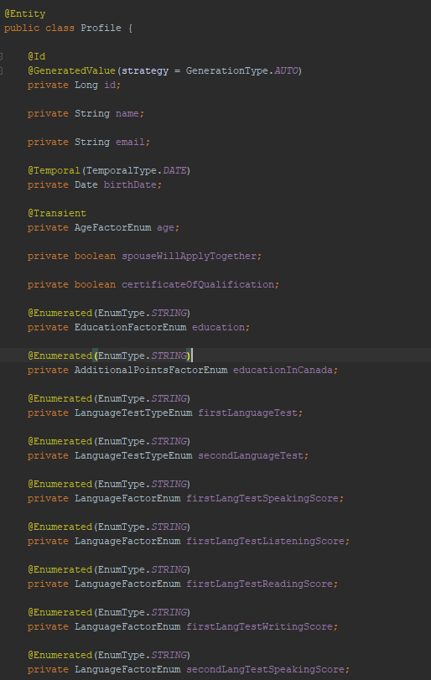
How to annotate an Entity

Slide 9
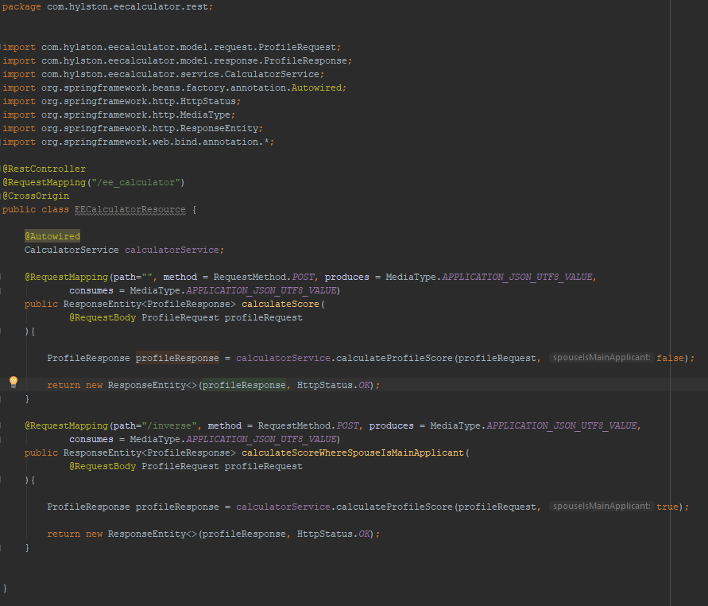
Rest Controller Class

Slide 10
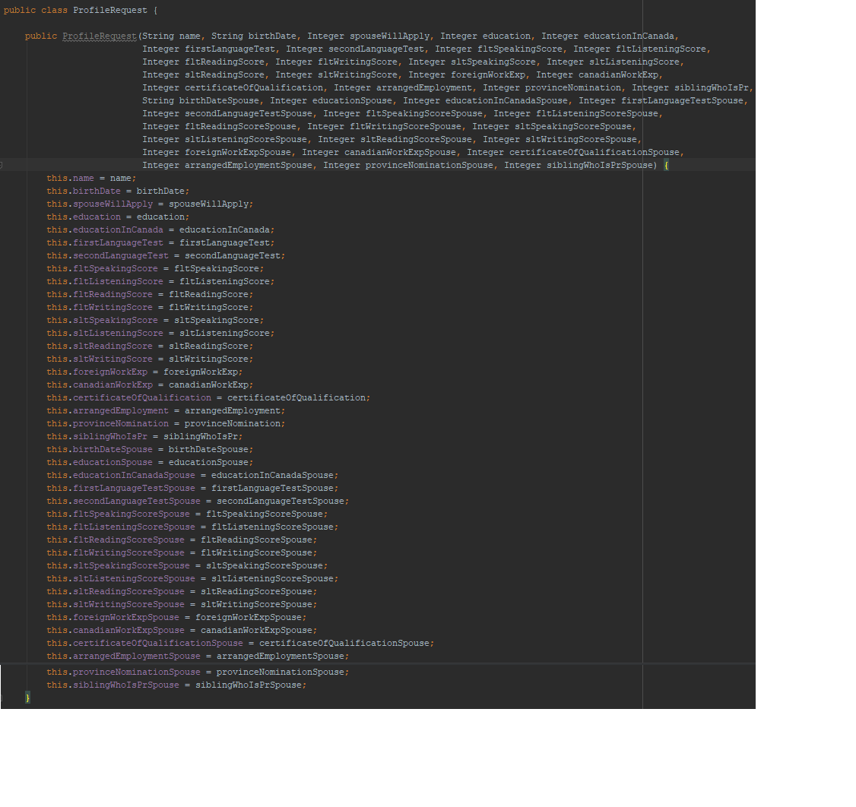
How to get the params

Slide 11

Tool to work with APIs

Slide 12
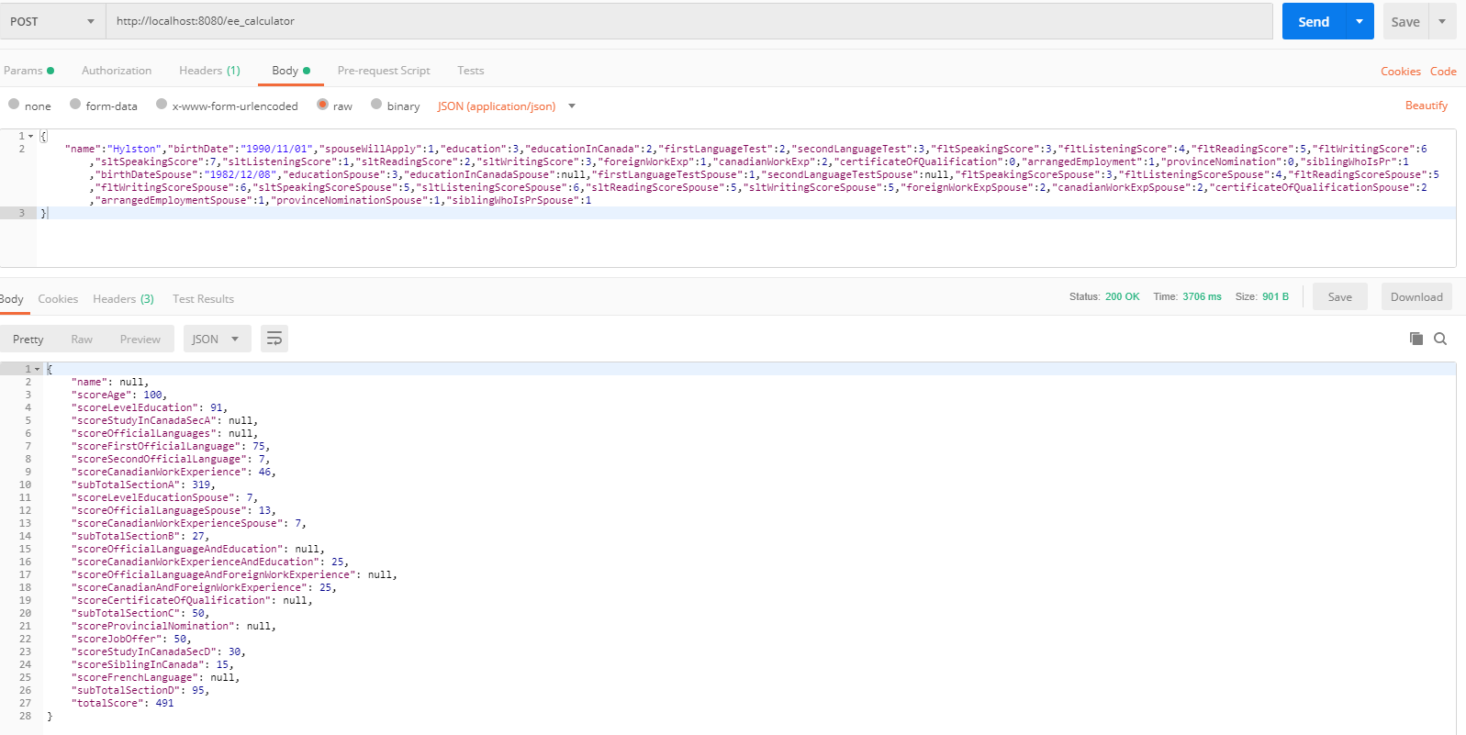
Using Postman – Post Request

Slide 13
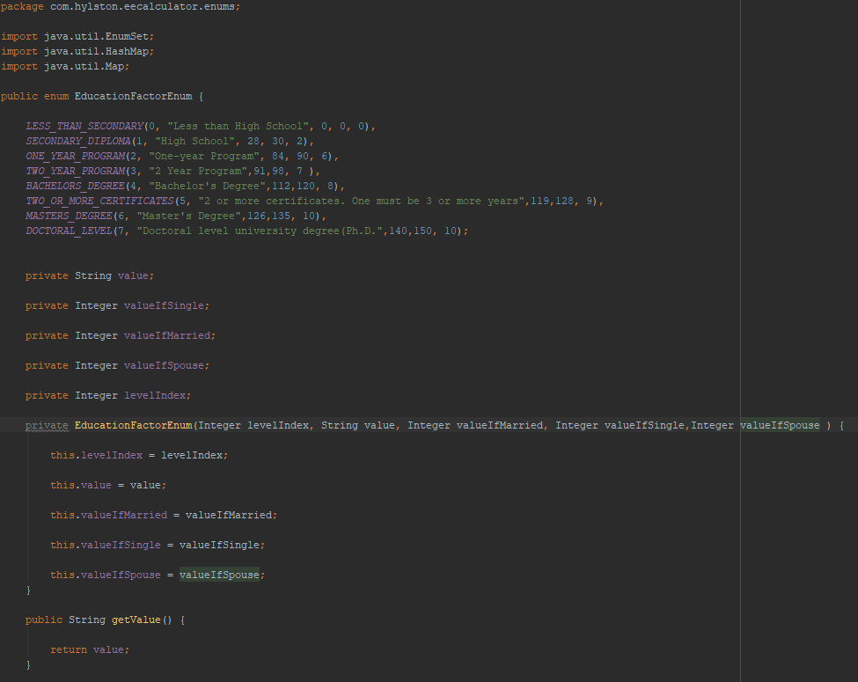
Example of Enum in Java

Slide 14

Front-End

